Slide 1
PROJECT TITLE: CLIMATE CHANGE AND ENVIRONMENTAL DATA ANALYSIS USING BIG DATA TOOLS
Group 3
Student 1: Emily 219100462 student 3: karibu 219125031
sTudent 2: Auguste 225165031 student 4: kreesan 225178176

Slide 2
Introduction
Climate change is an urgent global challenge driven largely by human activity.
Massive climate datasets require scalable tools for processing and analysis.
Big Data technologies provide a powerful solution to derive meaningful insights.

Slide 3
Problem Statement
Environmental datasets are growing in volume, velocity, and variety.
Traditional systems struggle with scalability and real-time analysis.
Lack of accessible data visualization tools hinders informed decision-making.

Slide 4
Project Objectives
Apply Hadoop and Hive to process historical climate data.
Use Power BI to visualize global temperature anomalies.
Forecast future climate trends using data analytics.
Demonstrate Big Data’s role in climate awareness and action.

Slide 5
Tools and Technologies Used
HDFS: For distributed data storage
Apache Hive: For data querying and summarization
Microsoft Power BI: For interactive data visualization and forecasting
Data Source: NOAA and NASA temperature anomaly datasets (CSV format)

Slide 6
System Architecture
End-to-end pipeline:
Data Source → HDFS → Hive → CSV Export → Power BI
Ensures scalability, efficiency, and visualization readiness

Slide 7
Methodology Overview
Download dataset from NOAA
Load dataset into HDFS using Cloudera VM
Query and summarize data using Hive SQL
Export processed results as CSV
Import into Power BI for charting and forecasting

Slide 8
Hive Implementation Highlights
Table creation and data loading using Hive
Sample SQL Query:
SELECT year, AVG(temp_anomaly)FROM climate_dataGROUP BY yearORDER BY year;
Data exported to local directory for visualization

Slide 9
Power BI Visualization
Line chart illustrates temperature anomaly trends (1850–2023)
Forecast line (2024–2033) indicates rising global temperatures

Slide 10
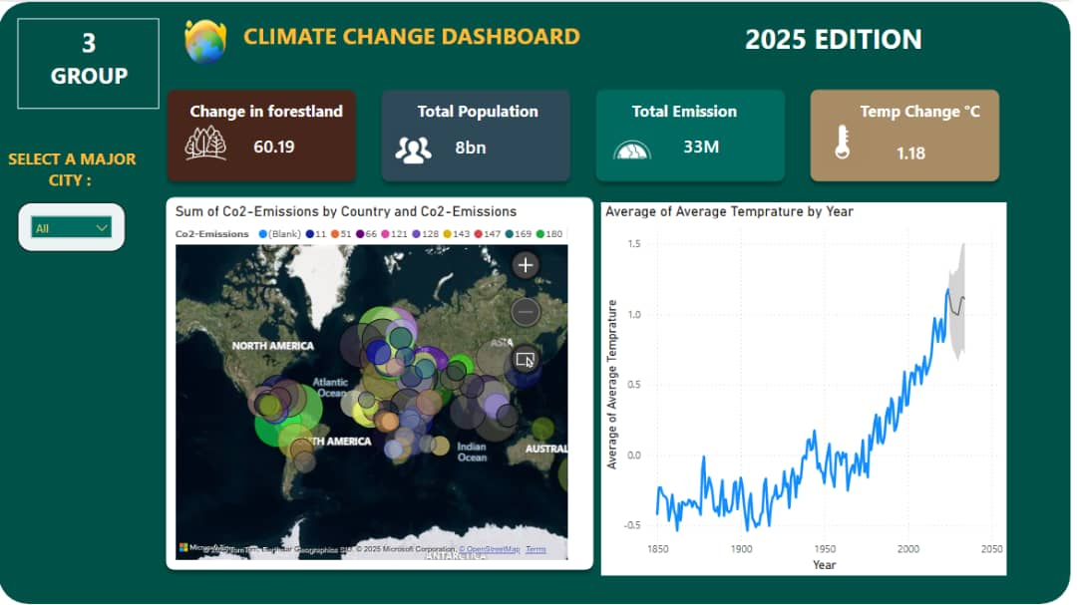

Slide 11
Forecast Analysis
Power BI forecast shows a continuous upward trend in anomalies
Indicates persistent global warming if trends continue
Useful for raising awareness and informing environmental policies

Slide 12
Limitations of the Study
Focused only on temperature anomalies
No real-time data ingestion (e.g., streaming)
Forecasting based on historical trends (no ML models yet)

Slide 13
Conclusion
Big Data technologies are effective in processing environmental data
Hive enables efficient data summarization at scale
Power BI enhances stakeholder understanding through visuals and forecasts

Slide 14
References
NASA Earth Data: https://earthdata.nasa.gov/
NOAA Climate Data: https://www.ncei.noaa.gov/cdo-web/
World Bank API: https://datahelpdesk.worldbank.org/
Apache Hive: https://hive.apache.org/
Power BI Docs: https://learn.microsoft.com/en-us/power-bi/
Dean & Ghemawat (2008), MapReduce: Simplified Data Processing on Large Clusters

Slide 15
Thank You!!!
Questions and Feedback…

